Slide 1
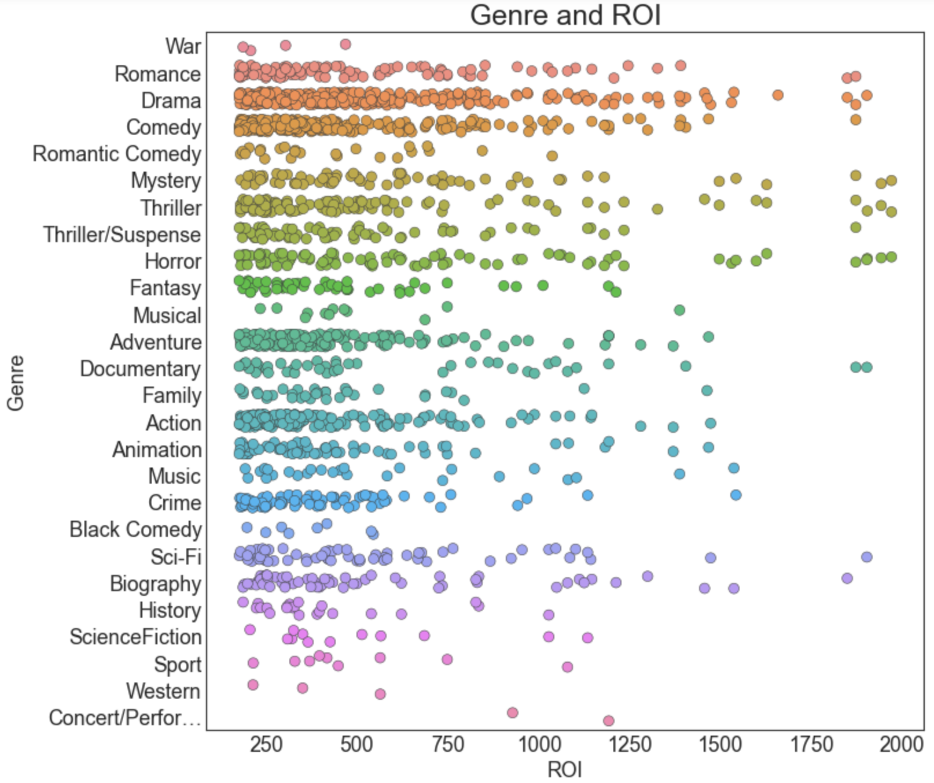
An Overview of ROI per Genre
Fully aware an initial foray into a new field for a specialized company requires tight margins and an understanding of risks, our analysis of the pre-COVID19 film market anchors itself on dollar use and high returns.
As such, before Microsoft allocates any of its resources into funding of a new studio, it’s best to understand the current state of the market and genre trends.
While there is further research to be done on the proliferation and profitability of Action/Adventure tentpole films (e.g., comic book movies, franchises, etc.), our analysis based strictly on ROI per genre suggests smaller, more inclusive films will net a higher return.

Slide 2
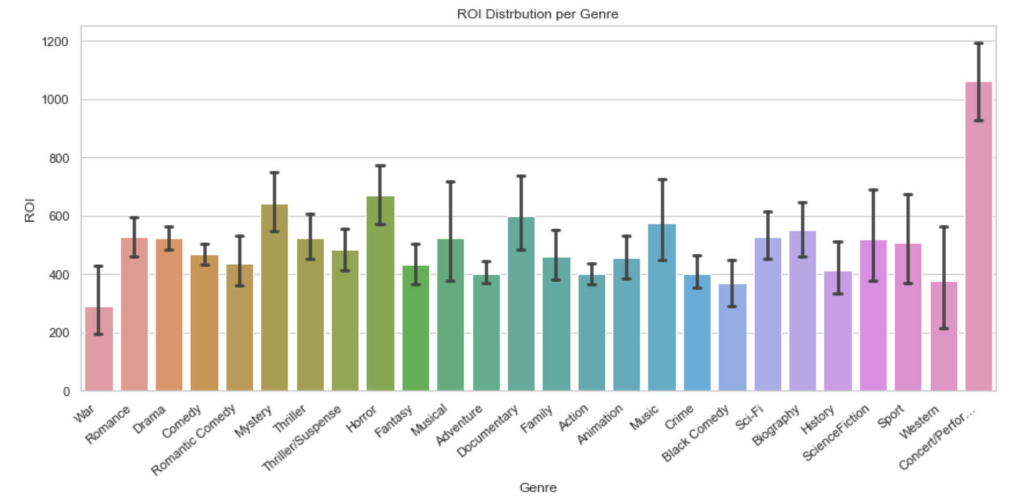
A Further Breakdown of ROI per Genre
As the last slide illustrated, smaller budgeted and more inclusive (per subject matter) films resulted in a a higher ROI.
While the aforementioned tentpole films often have a 200% or more ROI, other genre films double or triple those amounts.
Based on the prior two visualizations, we decided to take a closer look at four genres: Horror, Mystery, Romance, Drama, and Romance.

Slide 3
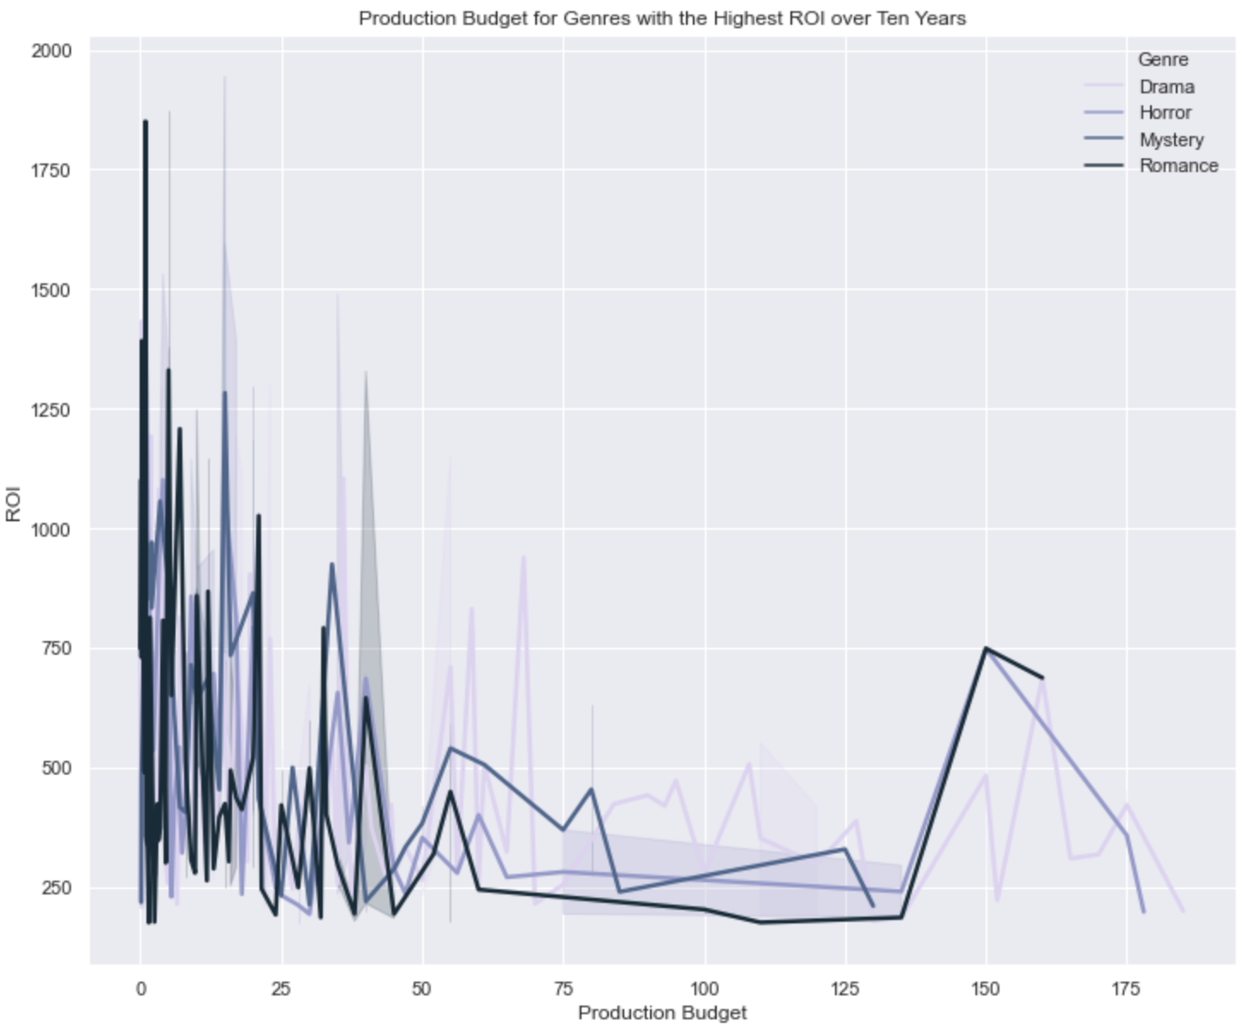
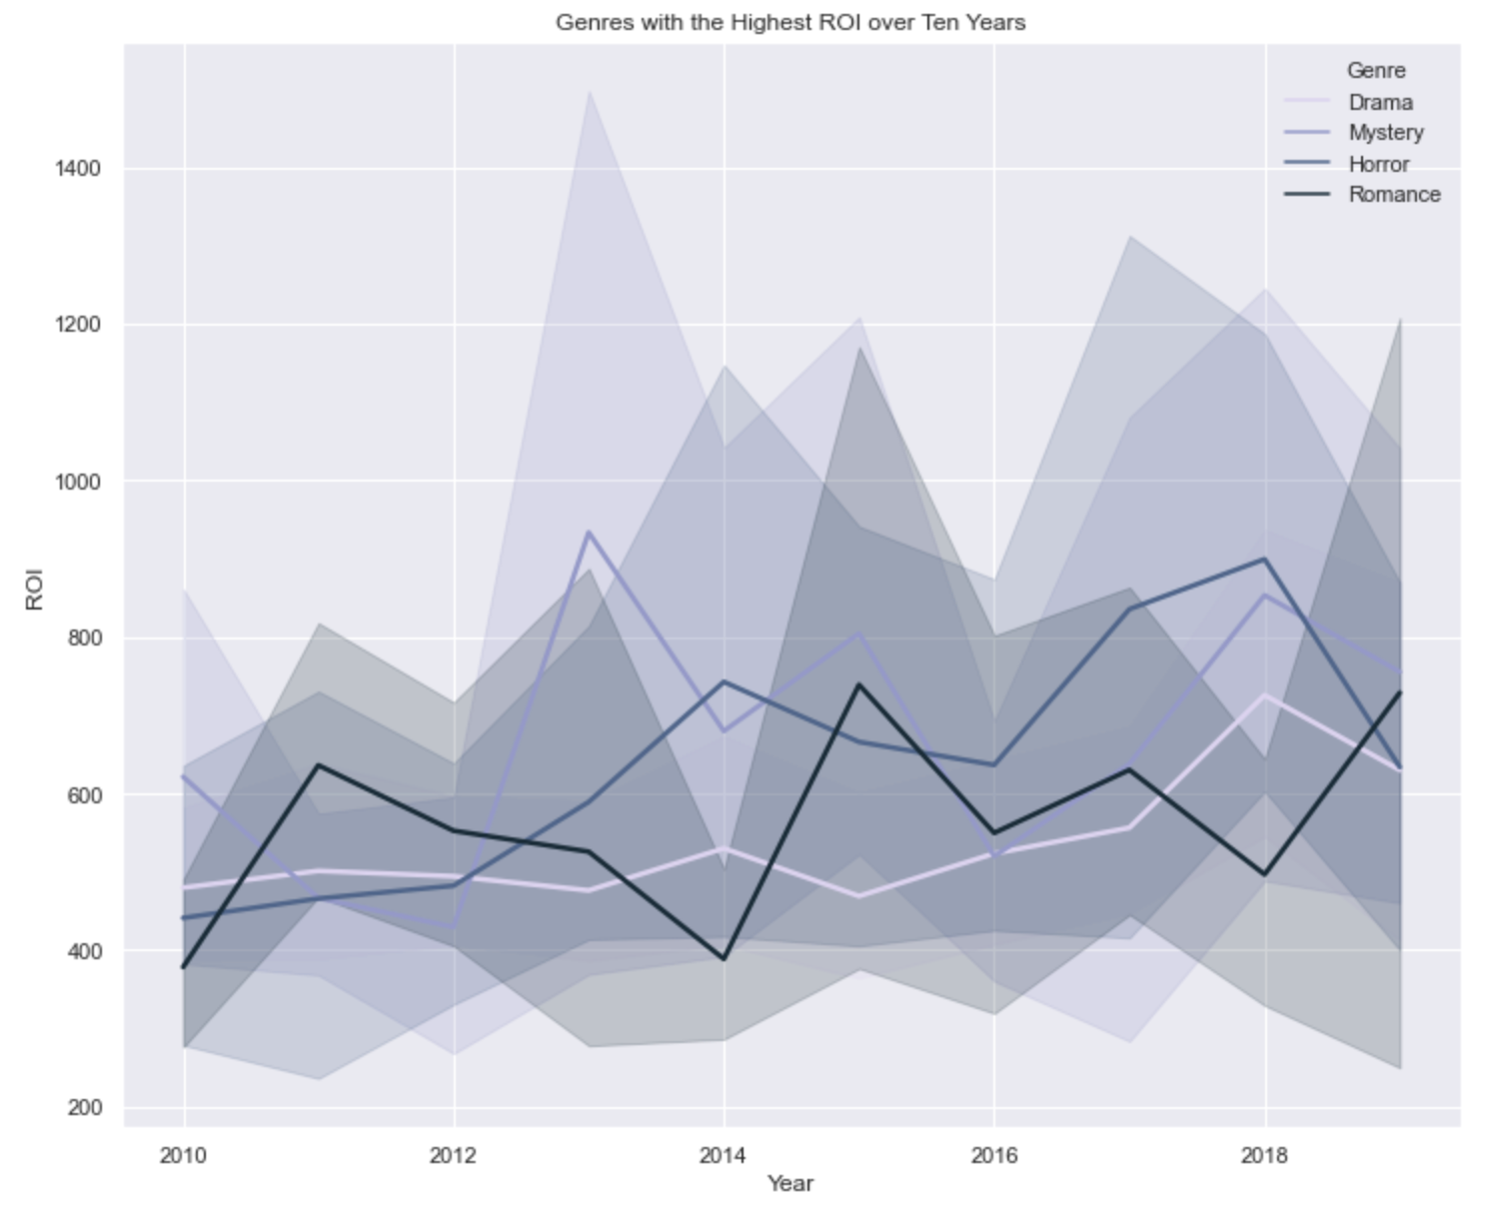
Budget Breakdown and Yearly Trends
Deconstructing the data over a ten year period, we can see our selected genres do well over an extended period of time, eliminating the need to search for outliers misconstruing our data.
Further confirming our initial suspicions, our genres chosen for analysis show a low financial investment with a high return rate.

